Slide 1
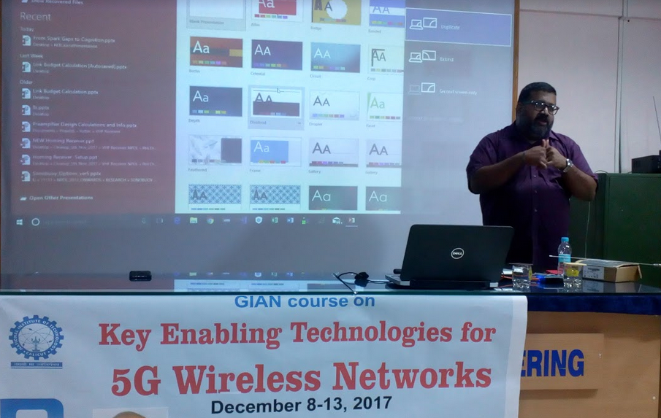
Ajith Peter, Research Scholar, CEN gave a talk on SDR and GPS

